Slide 1
Fake News Detection using Deep Learning Presented By Vaheedha Shaik -700754604

Slide 2
Motivation
Increasing anti-social behavior:
spreading of the misinformation
reactions of particular users like cyberbullying
It leads to influence personal opinions and can impact their decisions.
For Example - Elections

Slide 3
Problem statement
Need to detect and eliminate the various forms of anti-social behavior
Currently, human moderators are in charge of finding and revealing fake news
Time consuming
Resource consuming
Unreliable
Automating the process of detection of such behavior
To improve efficiency

Slide 4
Objectives
To create four different models for both classification tasks –
Title based classification
Text based classification
To explore if the title of the news article could be sufficient to decide
Model Evaluation - Comparing the performance of various neural network models trained.

Slide 5
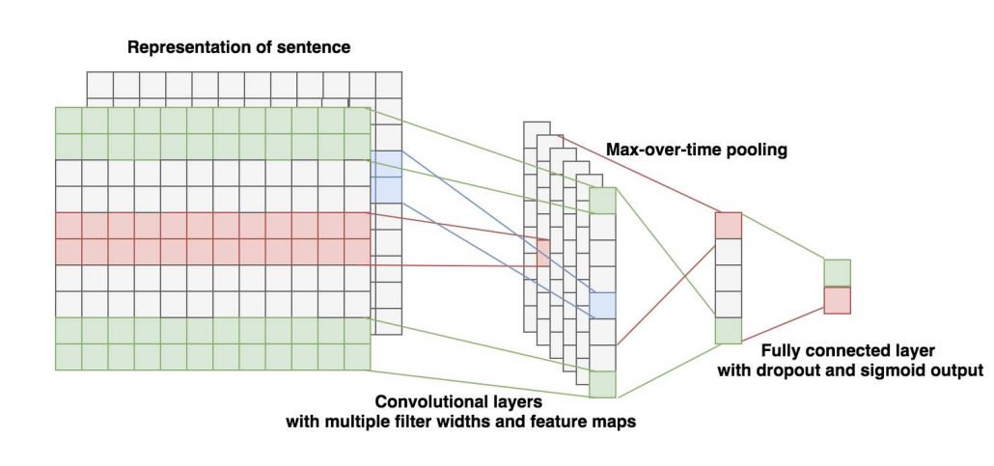
Contributions
Feedforward neural network
y = f*(x)
y = f(x; θ)
CNN
LSTM
layer of embeddings, Dropout(0.2), LSTM(100), Dropout(0.5), fully connected layer with 100 units and activation function ReLu, Dropout(0.2) and fully connected layer with activation function sigmoid.

Slide 6
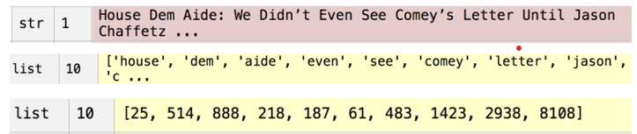
Methodology
Dataset – Taken from Kaggle
Each record consists of:
ID, Title, Author, Text, Label
Preprocessing
Word Embedding - Word2Vec algorithm is used

Slide 7
Methodology
Modelling
80/20 split
Four different models for both classification tasks
Model Evaluation
Accuracy, Percision, Recall, F1 score

Slide 8

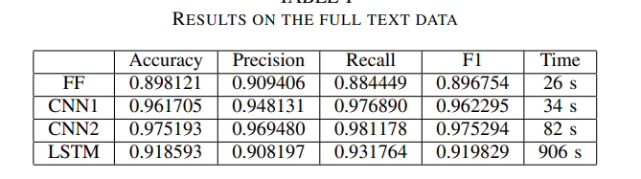
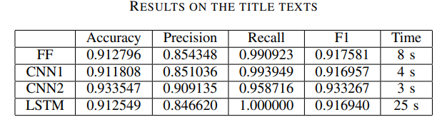
Results
Evaluated the performance of various deep-learning models.

Slide 9
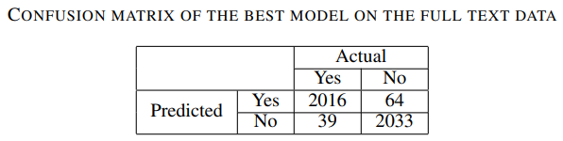
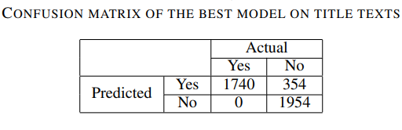
Critical Analysis
convolutional and LSTM models proved to be the most effective.
The models perform on a similar level both on full text and only title texts.
using only title for training proved to be effective during the training phase

Slide 10
References
C. Budak, “What happened? The Spread of Fake News Publisher Content During the 2016 U.S. Presidential Election,” 2019, pp. 139– 150.
J. C. Reis, A. Correia, F. Murai, A. Veloso, F. Benevenuto, and E. Cambria, “Supervised Learning for Fake News Detection,” IEEE Intelligent Systems, vol. 34, no. 2, pp. 76–81, 2019
M. Sarnovsky and N. Carnoka, “Distributed algorithm for text documents clustering based on k-Means approach,” in Advances in Intelligent Systems and Computing, 2016
T. Rasool, W. H. Butt, A. Shaukat, and M. U. Akram, “Multi-Label Fake News Detection using Multi-layered Supervised Learning,” in Proceedings of the 2019 11th International Conference on Computer and Automation Engineering - ICCAE 2019, 2019, pp. 73–77. [Online]

Slide 11

Presented By
Vaheedha Shaik - 700754604

Slide 12


